Slide 1
Marketing Mania

Slide 2
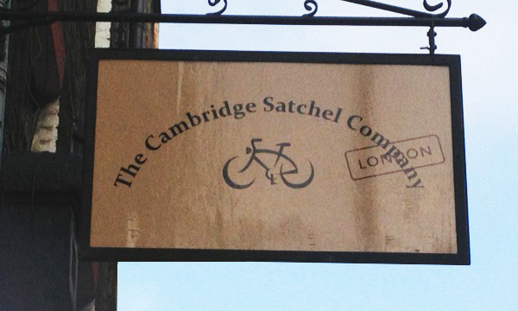
Introducing the Cambridge Satchel Company
Watch the video clip and read through the case study

Slide 4
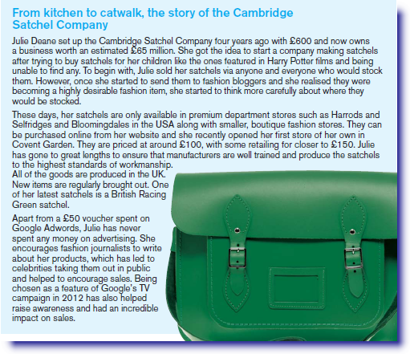
The Business Behind the Satchel

Slide 5
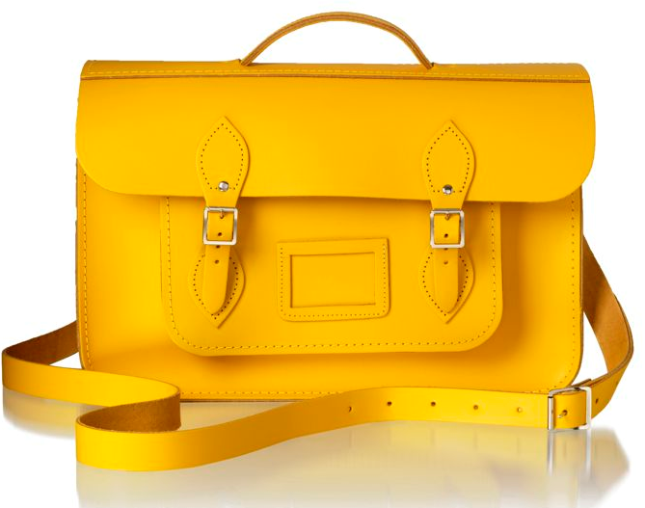
What goes into the marketing mix?
PRODUCT
PRICE
PROMOTION
PLACE

Slide 6
Identify an aspect of Julie’s business that matches to each
element of the marketing mix
PRODUCT
One of her latest satchels is a British Racing Green Satchel
PRICE
They are priced at around £100 with some retailing for closer to £150
PROMOTION
Encourages fashion journalists to write about the products
PLACE
Only available in premium stores such as Harrods, Selfridges, Bloomingdales

Slide 7
Which aspect of the marketing mix do you think is the most important to the Cambridge Satchel company and say why?
PRODUCT
Product is the most important
Say why and apply to Cambridge Satchel Company
because....it is only by having a high quality, distinctive and desirable product that Cambridge Satchel Company have loyal customers. Because the product is so desirable, this adds significant value enabling Cambridge Satchel Company to charge a higher price which results in greater profit.
PRICE
PROMOTION
PLACE

Slide 8
Examiners Tip
Contextualise...
Many of the questions want you to respond based upon the business scenario. Consider the factors that make this business unique and relate to these when answering the questions.

Slide 9
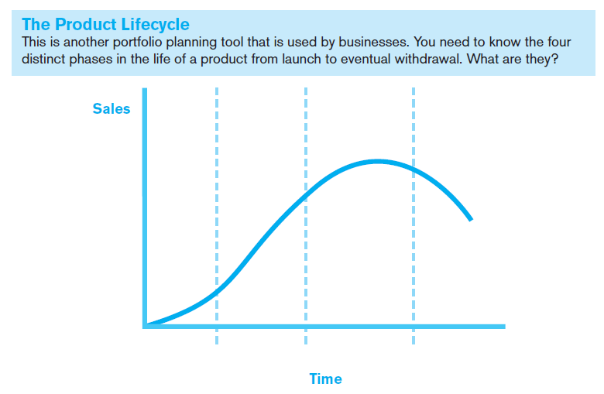
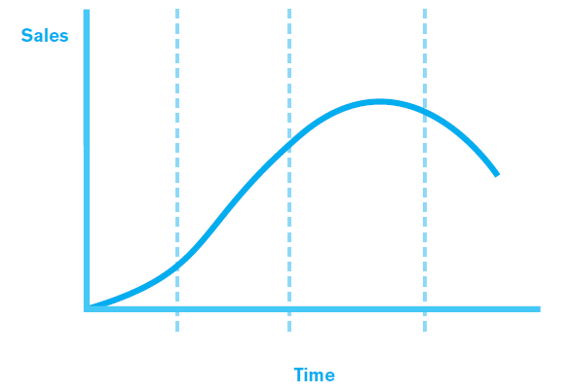
Maturity
Decline
Growth
Launch

Slide 10
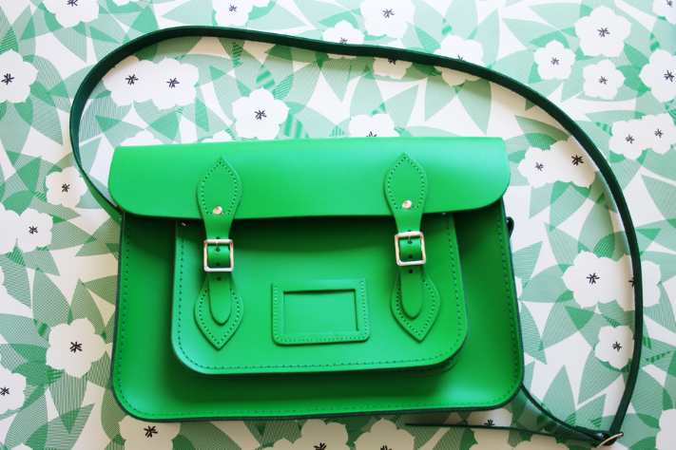
SALES
TIME
If sales are about to fall they can take action to attempt to prevent this by reviving interest in the product or brand. This is called an extension strategy.

Slide 11
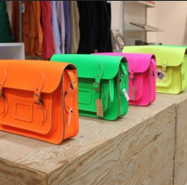
Identify one extension strategy used by Julie Deane, and explain how this would prevent sales from falling
(3 marks)

Slide 12
Extension Strategy?
Point
Explain
Expand
One strategy Julie could use is to develop new colours and styles of satchel.
This is because Julie’s products are sold in fashion stores to customers who like to ensure they have the latest look.
Therefore customers who previously bought a satchel are likely to return to Cambridge Satchel Company and buy a newer, more fashionable colour or style.

Slide 13
Branding? Differentiation? What’s the difference?
Branding and differentiation are both ways of getting products to stand out in a competitive
market. But there is a slight difference. Branding involves developing an image for your
product range so that it appeals to certain target customers. Differentiation involves offering
something rivals do not in terms of what the product does or the service that is offered.

Slide 14
Branding or Differentiation?
Branding
Differentiation

Slide 15
Cambridge Satchel Company Branding and Differentiation

Slide 16
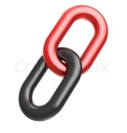
Question
I think Julie has used branding
Do you think Julie has used branding or differentiation to
make her product stand out?
Explain one advantage this has had for her.
She has done this by creating an
advertisement with Google about her business.
As a result Cambridge Satchel Company’s name has become extremely well-known and associated with high quality satchels.
This means that more customers now visit Julie’s website, stockists or Covent Garden store in order to buy her products.

Slide 17
What’s the Question?
One benefit is that the business can find out what sort of products customers are looking for. This means they can create products that meet their customers’ requirements, which will result in the business achieving a better sales revenue and consequently a greater level of profit.
Q: Describe one benefit to a business of carrying out market research

Slide 18
What’s the Question?
One benefit is that the business can understand what customers are looking for which is extremely important in a market where trends and tastes change very quickly. If the business can quickly respond to what customers are looking for by producing clothes that match the latest trends, they are far more likely to sell greater numbers of products at a profitable price. This will mean greater sales revenue and in turn a better overall profit.
Q: Describe one benefit to a business such as Top Shop of carrying out market research.

Slide 19
Examiners Tip
Answering the question set
Read the questions very carefully. In the past some students have drifted away from the question set or turned the question into something else! You must ensure that they understand what the question is asking before you start your response

Slide 20
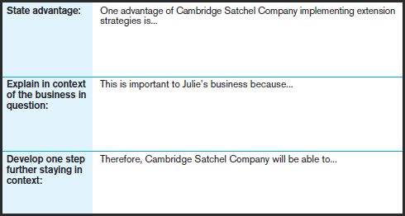
Explain one advantage to Julie Deane of ensuring Cambridge Satchel Company implements extension strategies (3 marks)
that this would enable her to ensure her products remained of interest to her potential customers.
she operates in an industry where fashions and tastes are constantly changing and Cambridge Satchel Co needs to offer the latest trends.
stay ahead of the wide range of other bag and satchel companies that have come in to the market since Cambridge Satchel Co’s success.

Slide 21
Examiners Tip
Avoid repetition
The layout of the exam may mean you are asked to identify an advantage and then to explain it. Do not repeat the advantage / disadvantage in your explanation – this is wasted space and wasted time. You will not gain any additional marks for this. Also, avoid repeating the information in the case study in your own words!

